Slide 1

OUR DEVELOPERS
Tip-top Bakery
Eslam Magdy Rezk Ebrahim Hassanin Jerry Justin
Dustin Augssalim
Sundy Fhan
Avin Mahajan

Slide 2
Tip-top Bakery (business process)
System Analysis and Design-SAAD (052021-SLS)
1- Registration
4- Confirm order
The customer will register his data through the website
After customers choose the food, they can pay and confirm the order, also but his information details such as, address and tele.
2- Acceptation
Tip-top Bakery
5- Waiting for delivery
The employee accepts the registration request from the Members
The customer waits for the order until it reaches his address
3- View menu
6- Datastore
Customers can enter the menu and buy baked goods
All customer information is stored in the system

Slide 3
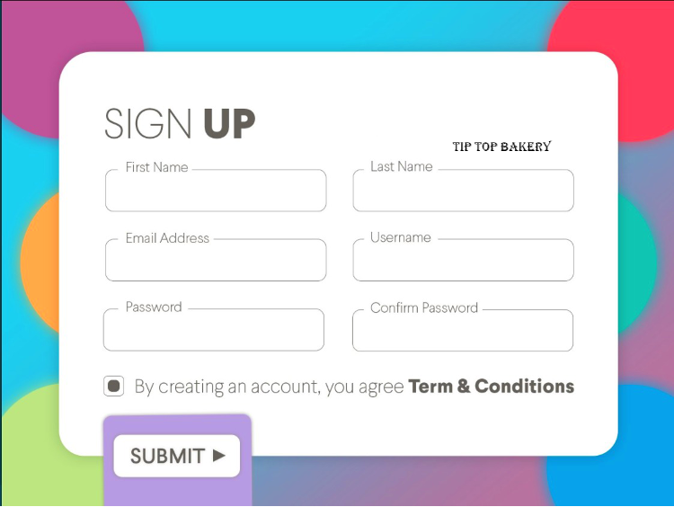
Prototype – Sign Up
01
Sign up
The customers need to sign up, to access to website of tip-top bakery.
04
Staff & Registration
Send all forms of registration to staff to approve or reject it.
02
Data Entry
The customers need to write details about them.
03
Terms & Conditions
The customers need to accept the terms before submit the form of the registration.
Present by Eslam Magdy Rezk Ebrahim Hassanin

Slide 4
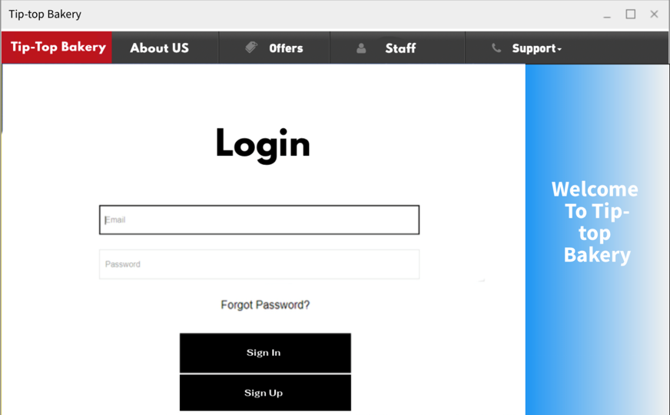
Prototype – Log in
Log in Interface
Account Security
Data Store
The customer should write his user name and password then click sign in.
The system will verify the validity of the data by comparing it in the data base.
Present by Eslam Magdy Rezk Ebrahim Hassanin
Next slide is represented by Jerry Justin

Slide 5
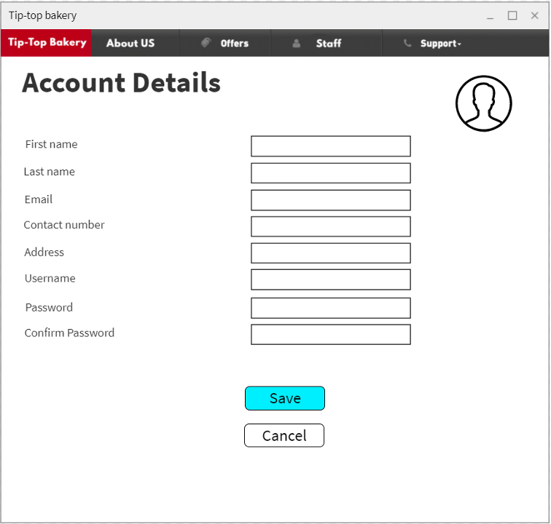
Prototype – Account Details
Update information
New Information
Check validity
The customer can update his data in the system
The data is checked, validated, and then approved
Present by Jerry Justin

Slide 6
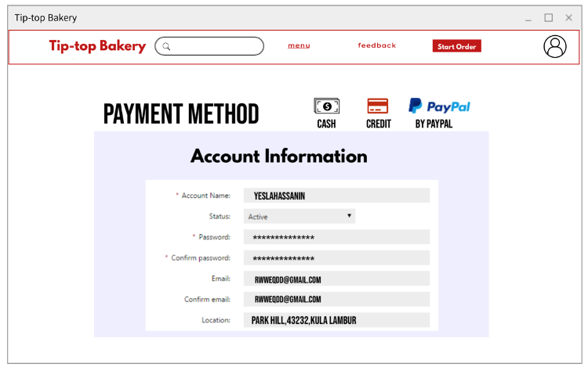
Prototype – Account Information
01
The customer manages his payment method
02
The customer should make sure about entered location
Manage information before ordering
03
Update data information
04
Save the information in Customer Datastore
Present by Jerry Justin
Next slide is represented by Dustin Augssalim

Slide 7
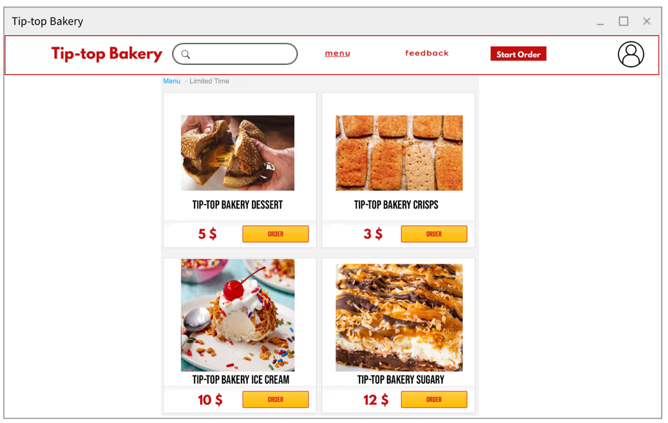
Prototype – Main menu
Menu Information
Decision
After ordering the food customer can take many of decision like start order
All Foods that customer need, it will be shown after logging in
Feedback
Buttons
If customer needs aby help, he can press on feedback button
Customer will see many buttons to help him during browsing
Present by Dustin Augssalim

Slide 8
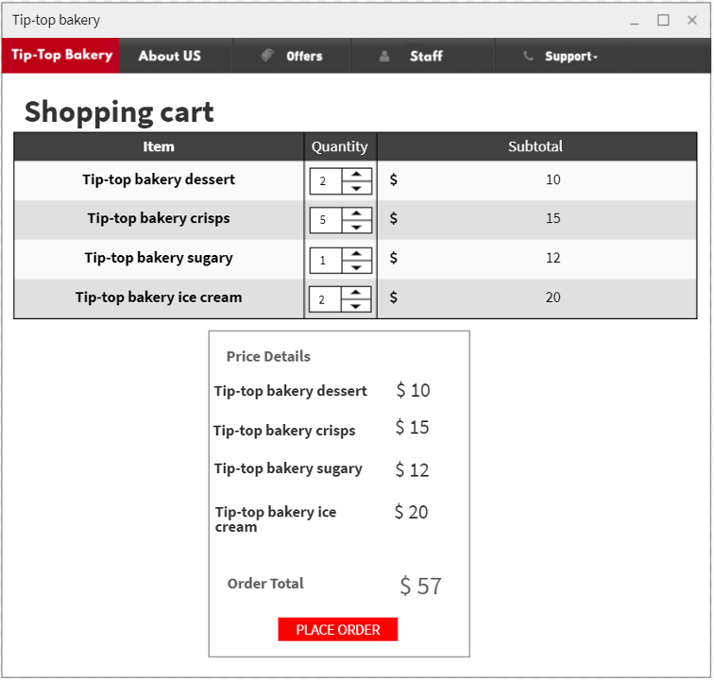
Prototype – Cart
Showing the total price
Cost
Adding shipping fees, if there is no voucher
Shipping
Achieving the highest levels of global security when paying the amount
Security
Quantity
Customer can edit in quantity of the order before placing it
Support
There is a support button if the customer faced any problem
Present by Dustin Augssalim
Next slide is represented by Sundy Fhan

Slide 9
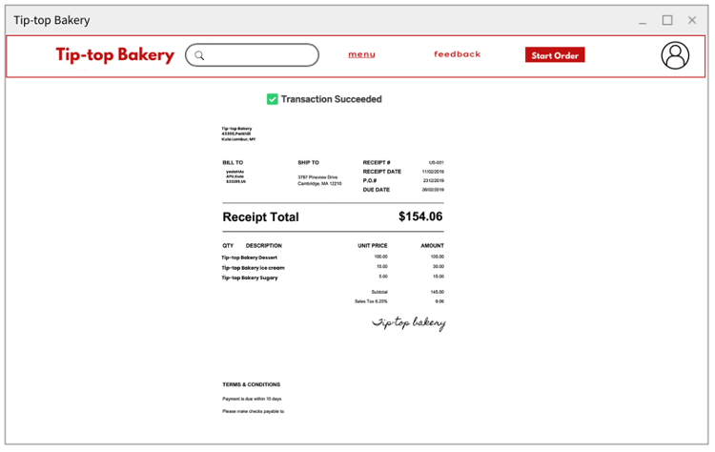
Prototype – Receipt
After confirming the payment, a confirmation message will be sent to the mobile number and also to the accounts of Facebook and other applications, confirming the receipt of the amount.
Present by Sundy Fhan

Slide 10
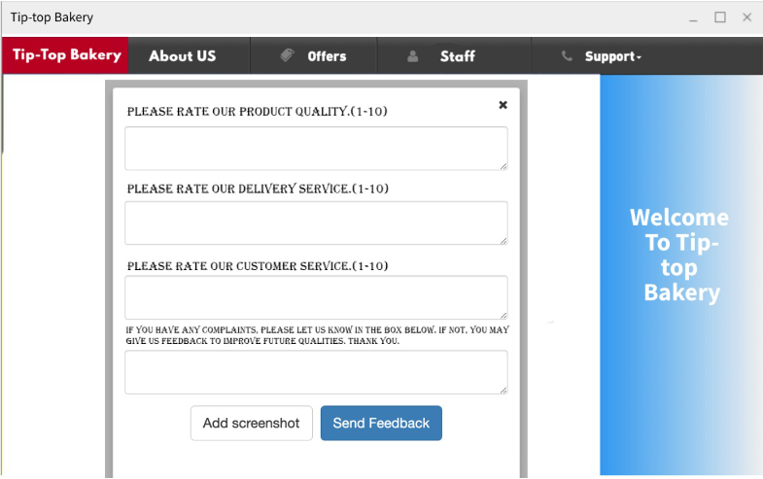
Prototype – Feedback
50%
Delivery
92%
Food
83%
Supports
77%
Customer service
Present by Sundy Fhan
Next slide is represented by Avin Mahajan

Slide 11
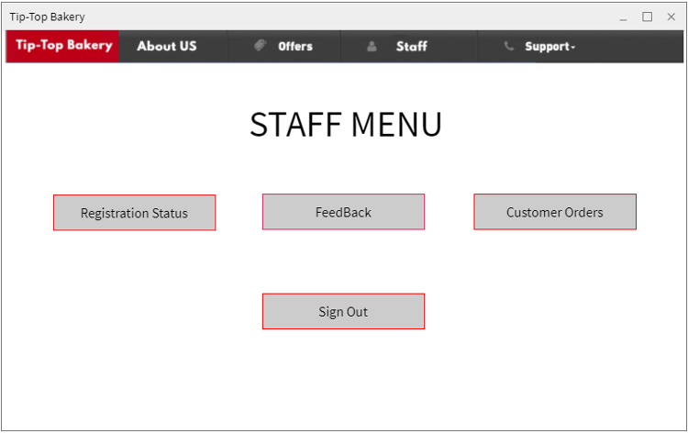
Prototype – Staff Menu
Registration status
Feedback
Staff can approve or reject forms
View Customers Feedbacks
Customer Orders
Sign out
Accept or reject customers orders
Staff account sign out
Present by Avin Mahajan

Slide 12
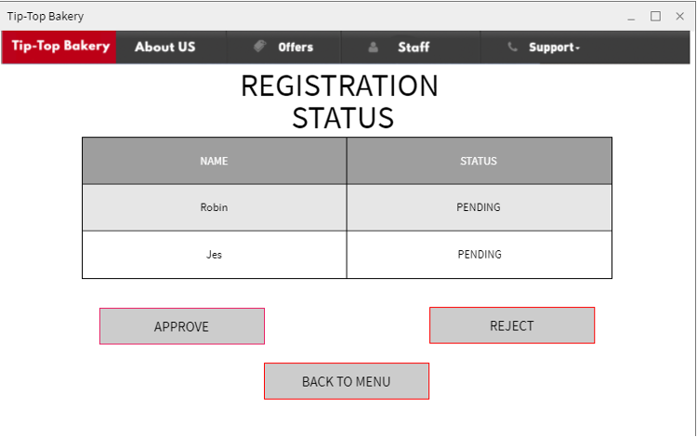
Prototype – Staff Registration status
Confirm
If all the user data is correct, his request will be approved
Approved
Rejected
Approved
Rejected
Present by Avin Mahajan

Slide 13
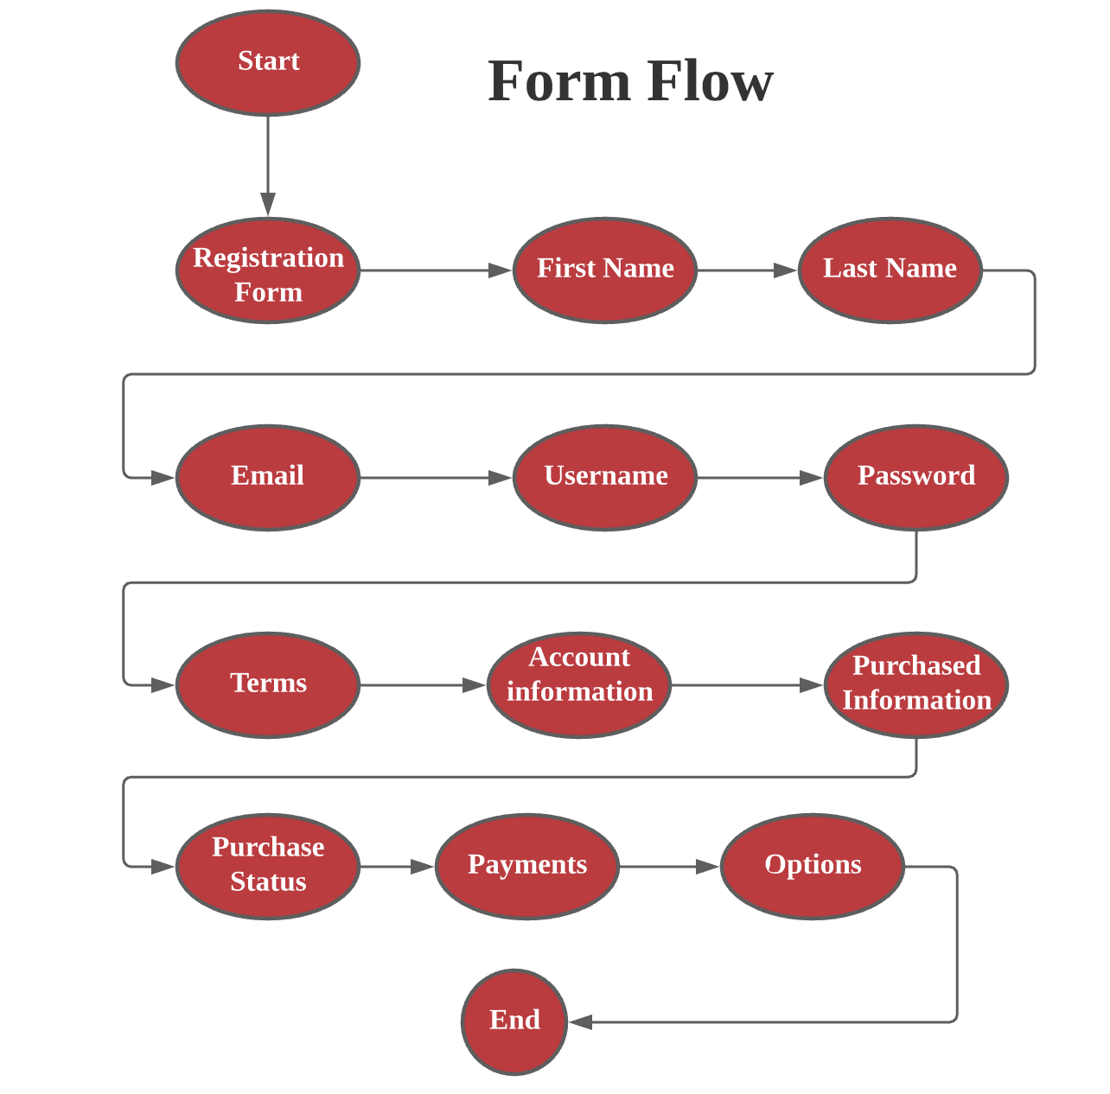
Interface design guidelines (Input – Form Flow)
Customer information
Customer need to fill his information
Account information
Customers review account information

Slide 14
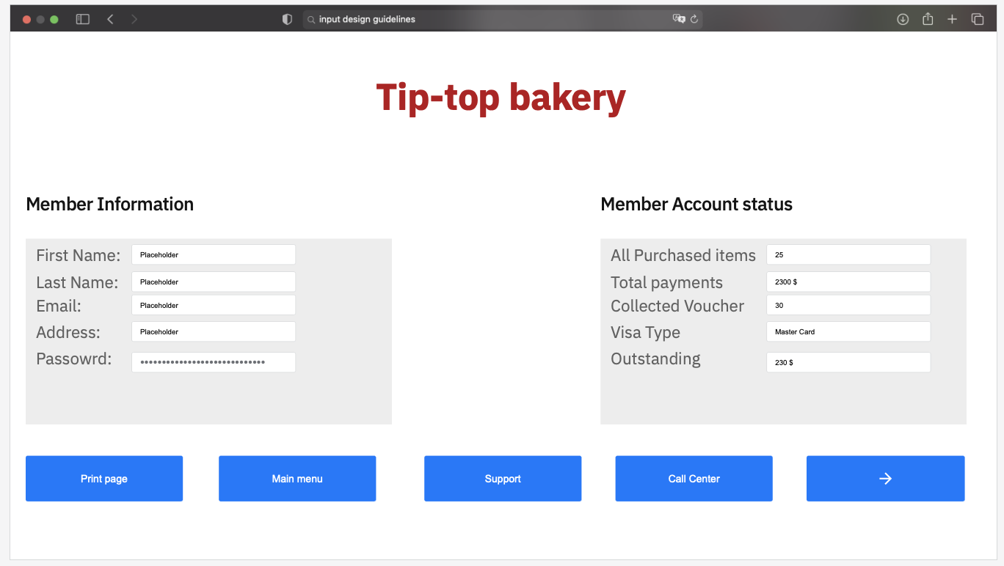
Interface design guidelines (Input – Grouping of information)
Easy to fill Member information
Easy To Review Account status
Customers have many options

Slide 15
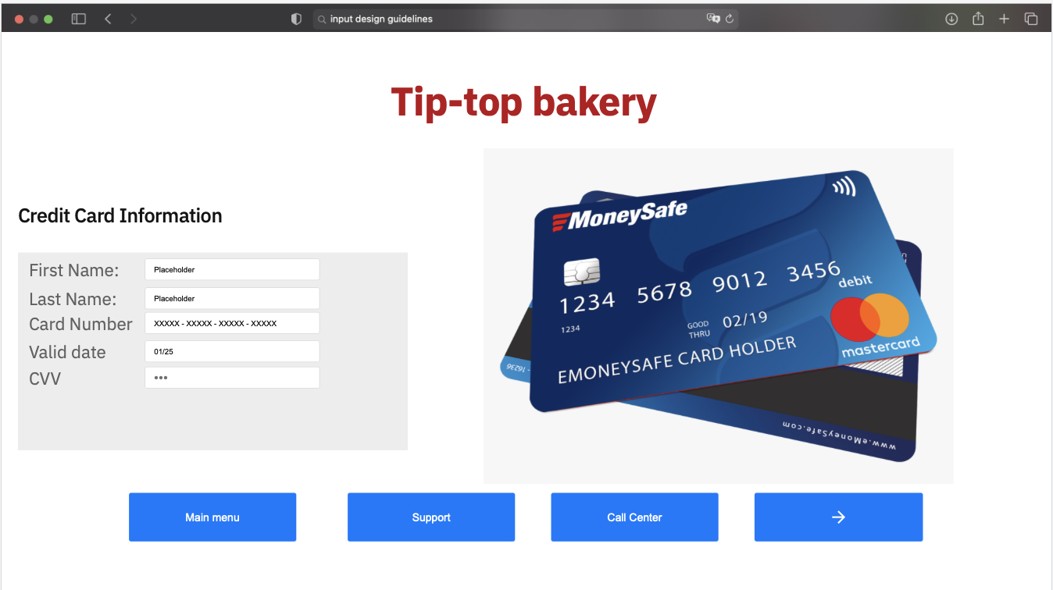
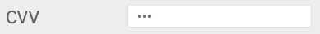
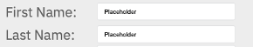
Interface design guidelines (Input – Grouping of information 2)
Easy to fill Credit Card information
Customers have many options
Input validation
Captions - inbox

Slide 16
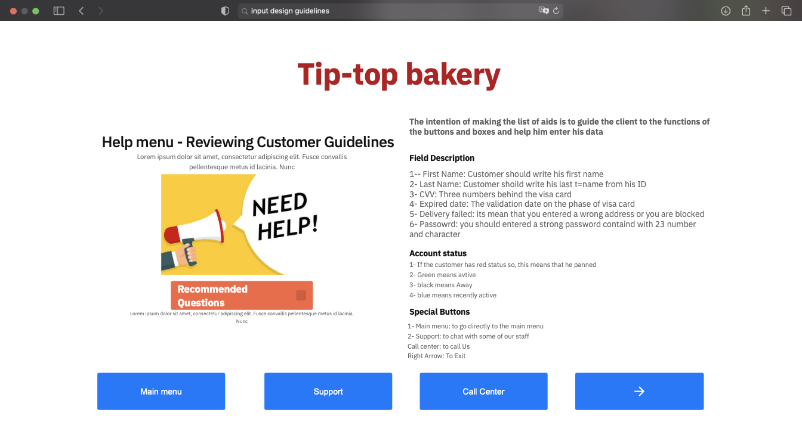
Interface design guidelines (Output – Help Menu)
In help menu, I was considered that the appearance of the title, mixed case and the spaces between titles
Big Data Challenges

Slide 17
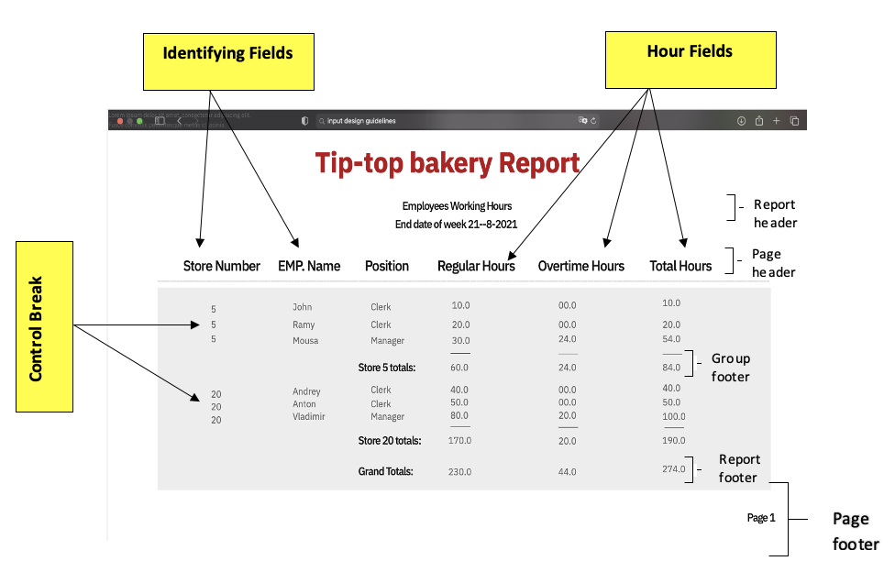
Interface design guidelines (Output – Detail Report)

Slide 18
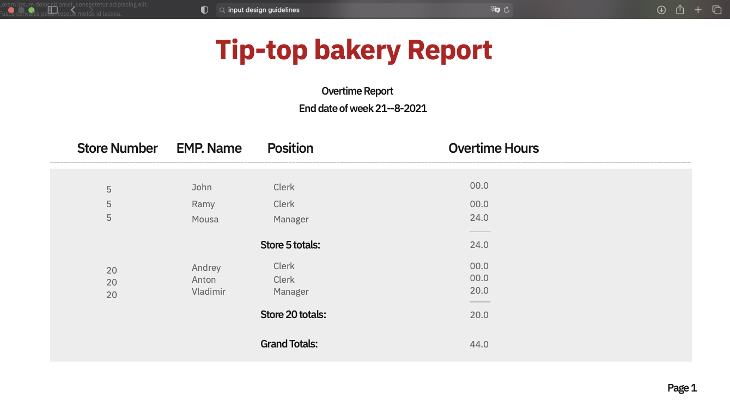
Interface design guidelines (Output – Exception Report)

Slide 19
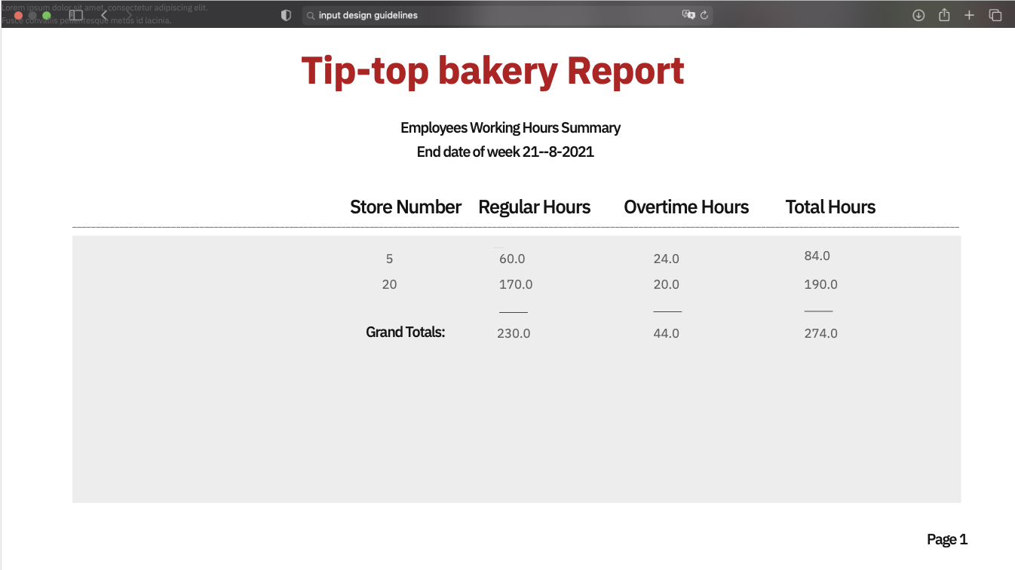
Interface design guidelines (Output – Summary Report)

Slide 20
End of presentation
This presentation describes how to analysis the data by system and data analysis by keeping the Thanks slide.
You are allowed to:
Learn and read this presentation.
Use it for increase your knowledge.
You are not allowed to:
Use this content in a personal way.
Use it in a research form without using references.
Change in the content.
Submit it at any website.
Copyright theft.
or more information about editin slides, please read our FAQs or visit Slidesgo School:
https://slidesgo.com/faqs and https://slidesgo.com/slidesgo-school

